Slide 1
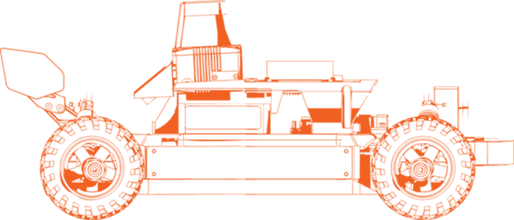


LAB-01
Developer Onramp
Chinmay Vilas Samak
Ph.D. Candidate
ARMLab, CU-ICAR
Email: csamak@clemson.edu
Tanmay Vilas Samak
Ph.D. Candidate
ARMLab, CU-ICAR
Email: tsamak@clemson.edu

Slide 2


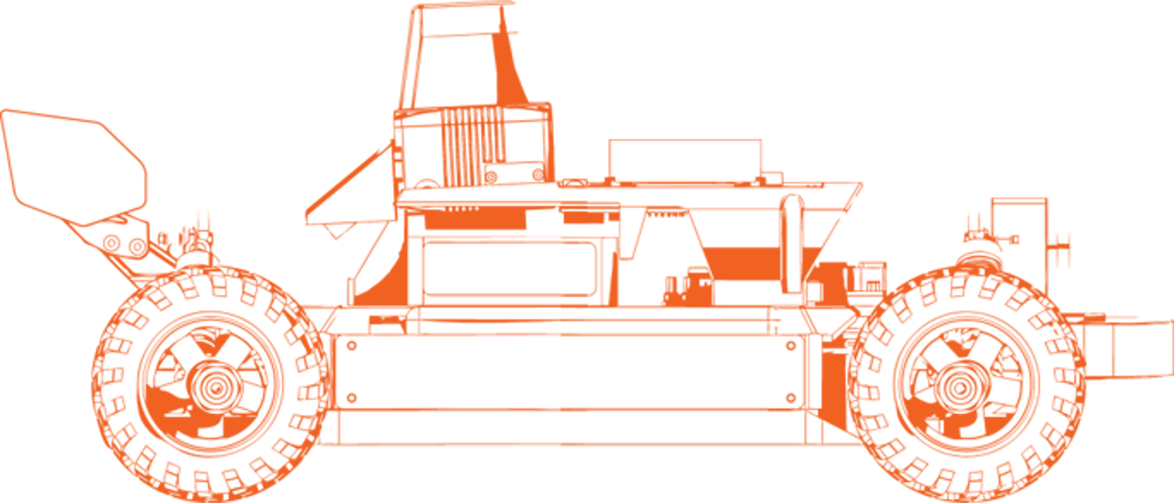

Lab Outline and Expected Outcomes
Development
  Linux (Ubuntu 22.04)
  Windows Subsystem for Linux (WSL 2)
Version Control
  Git
  GitHub
Containerization
  Docker
  Docker Hub
GOAL: Develop, collaborate, package & deploy seamlessly

Slide 3

Linux 101
Linux-101.md

Slide 4
Linux 101
Linux makes a developer’s life easy!
Course context: Autonomous vehicle projects often run on Linux because robotics tools, simulators, build systems, and embedded computing workflows are commonly developed for Linux.
Learning goals:
  Navigate the filesystem
  Create, inspect, copy, move, and remove files
  Search for files and text
  Understand paths, permissions, commands, and processes
  Manage packages with apt
  Use command history, redirection, and pipes
  Find help when a command is unfamiliar

Slide 5
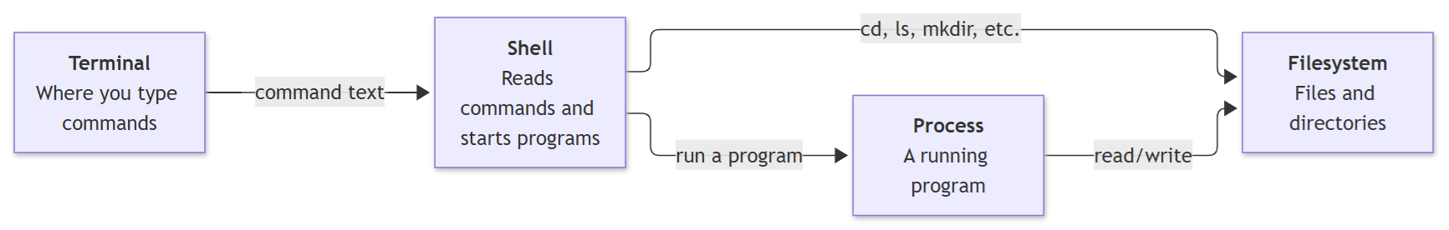
Linux 101
The terminal is the window where you type commands and see output
The shell is the program that reads your commands; Bash is a common shell on Ubuntu
The filesystem is the tree of directories and files beginning at /
A process is a program that is currently running
Most commands either inspect or change the filesystem, start a process, or connect these ideas together with pipes and redirection

Slide 6
Git 101
Git-101.md

Slide 7
Git 101
Git turns edits into traceable history!
Course context: Autonomous racing teams use Git to track changes to the autonomy stack, simulation configurations, and documentation. GitHub provides a shared platform for reviewing, testing, and integrating the project efficiently.
Learning goals:
  Create or clone a Git repository
  Understand working-tree, staging-area, and commit states
  Make focused commits
  Inspect history and changes
  Work with branches
  Connect a local repository to GitHub
  Pull and push changes
  Handle merge conflicts safely

Slide 8
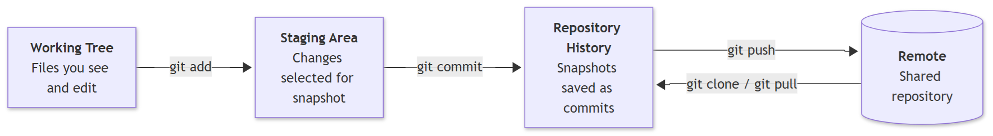
Git 101
The working tree is what you currently see and edit
The staging area is the exact set of changes selected for the next commit
A commit is a saved snapshot with an author, timestamp, identifier, and message
A remote repository is a shared copy of the repository on a hosting platform; GitHub is one example

Slide 9
Docker 101
Docker-101.md

Slide 10
Docker 101
Docker makes the environment portable!
Course context: Docker can give every student a consistent environment for the simulator, robotics middleware, build dependencies, etc. even when host computers differ.
Learning goals:
  Explain images, containers, registries, volumes, and bind mounts
  Run and inspect containers
  Map ports and files between host and container
  Write a basic Dockerfile
  Build and tag an image
  Use Docker Compose for a small multi-container setup
  Clean up resources safely

Slide 11
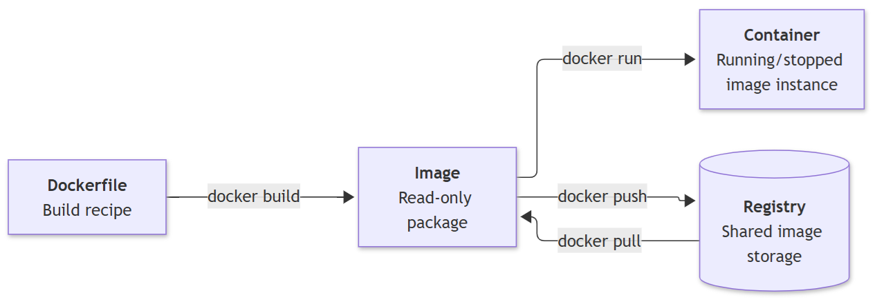
Docker 101
A Dockerfile is a recipe for building an image
An image is a read-only packaged filesystem and configuration
A container is a running or stopped instance of an image
A registry stores images; Docker Hub is one example
A volume stores data managed by Docker
A bind mount exposes a specific host path inside a container

Slide 12
Thank You!
Open to questions and discussion…

